Slide 1
Module 3
Grief First Aider - Handouts
Learning outcomes
Structure | Timings: 4.5 hours per module over three sessions. Regular breaks will be included.
Awareness​
Trauma​
Impact of being bereaved by suicide​.
Additional resources and support for grief support​
How to implement the Grief First Aider role in your workplace​
Skills​
How to identify traumatic loss and signpost​
How to support ​
Signposting​
Bringing it all together in your workplace
​In this module we have group cohesion, we have shared a space, and bring everything together. We tackle trauma, bereaved by suicide and the strategy to counter these using self-care.​
Notes or Questions

Slide 2
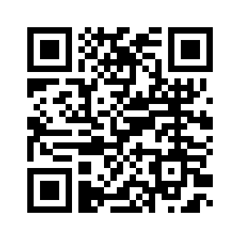
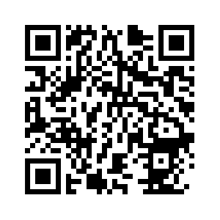
Signposting & support
Signpost to some of the more common resources
Cruse Bereavement Support: www.cruse.org.uk www.hopeagain.org.uk
WAY Widowed and Young: www.widowedandyoung.org.uk
Samaritans : www.samaritans.org.uk
Winston’s Wish: www.winstonswish.org.uk
Grief Encounter: www.griefencounter.org
Many more organisations: www.cruse.org.uk/organisations/signposting
Cruse Signposting
Help is at hand
booklet

Slide 3
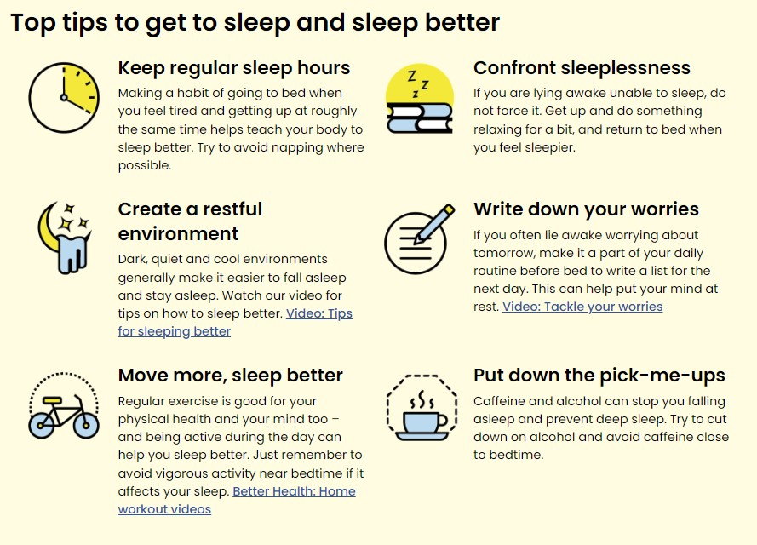
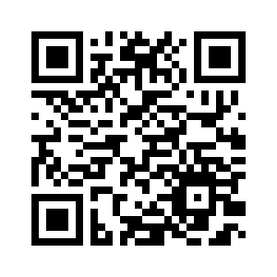
Signposting and support
Sleep

Slide 4
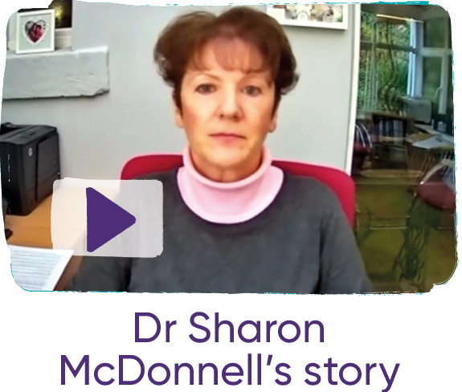
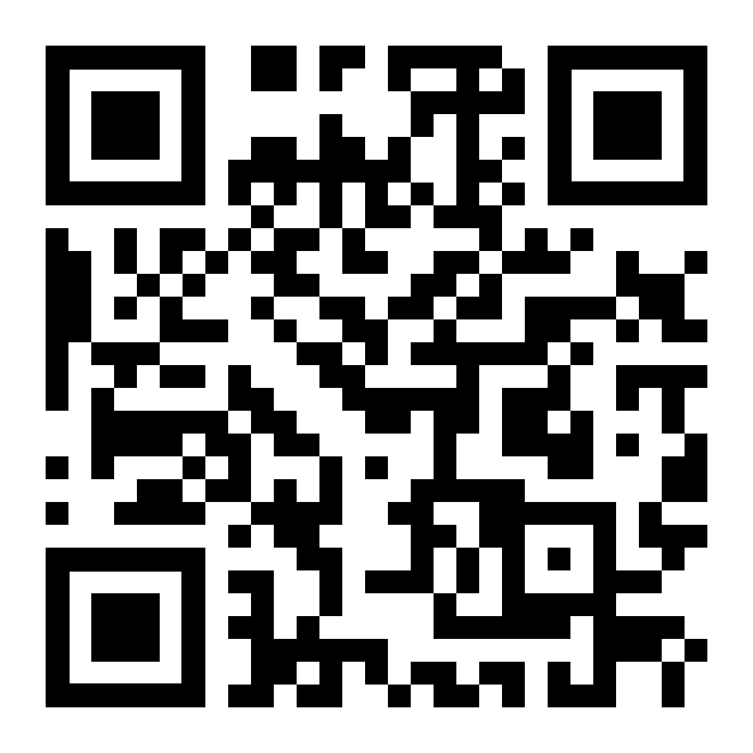
From Grief to Hope
This report, ‘From Grief to Hope’, comes from Manchester University and Support After Suicide Partnership, and shares the findings from a survey of over 7000 people bereaved by suicide, about the impact the bereavement had on their lives. It includes recommendations to governments, to employers and wider society about how to improve the support that’s available for those bereaved by suicide.

Slide 5
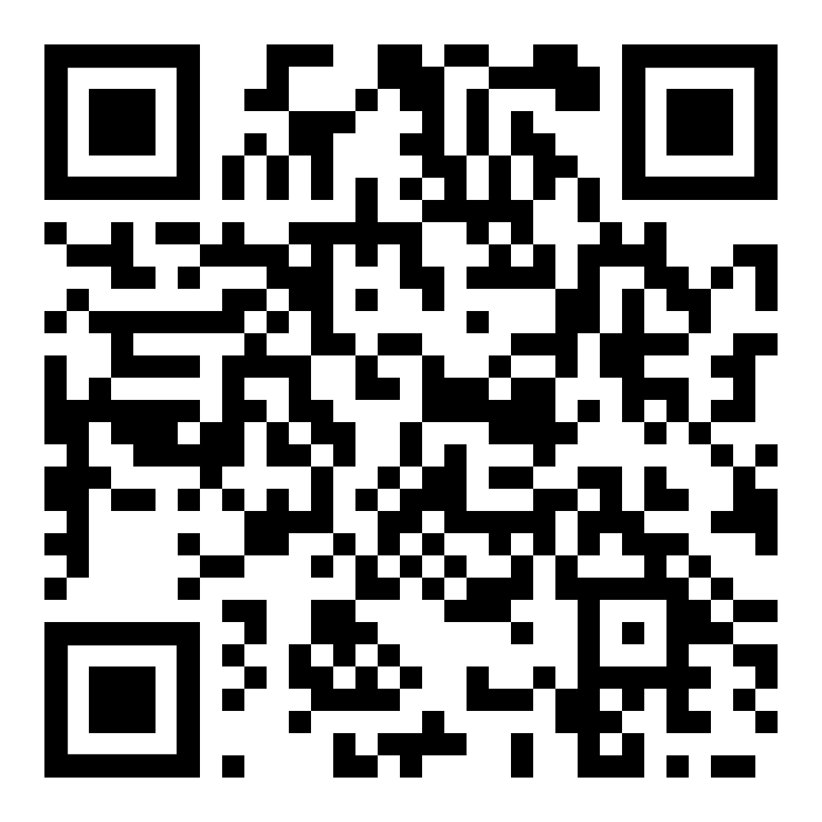
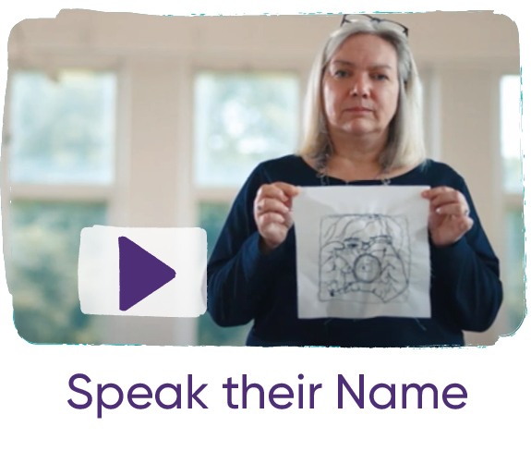
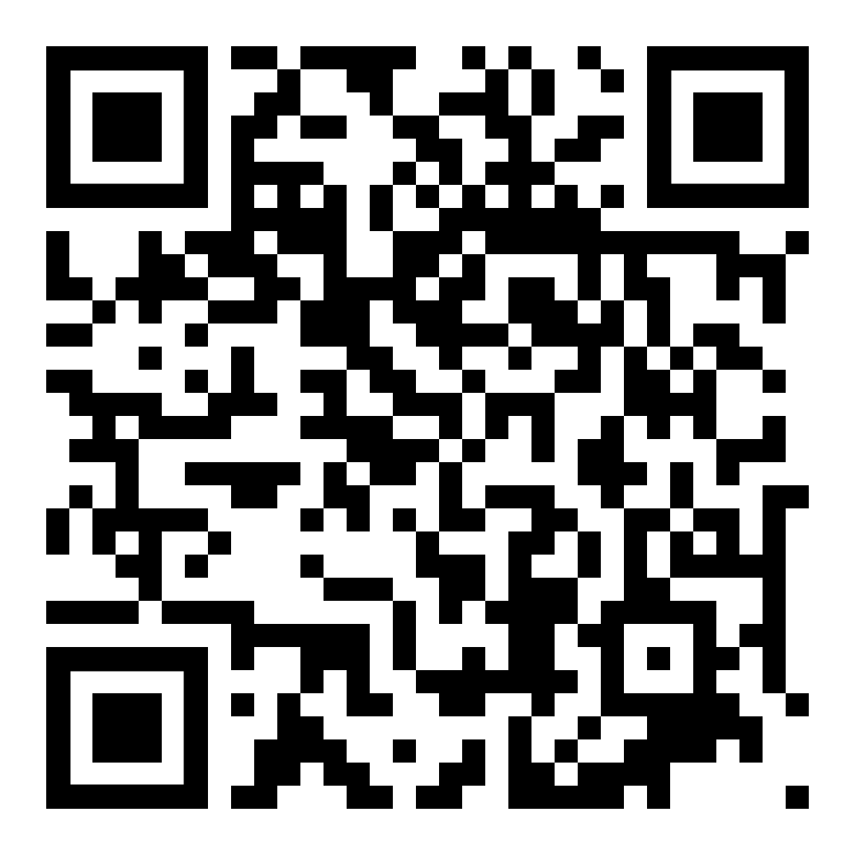
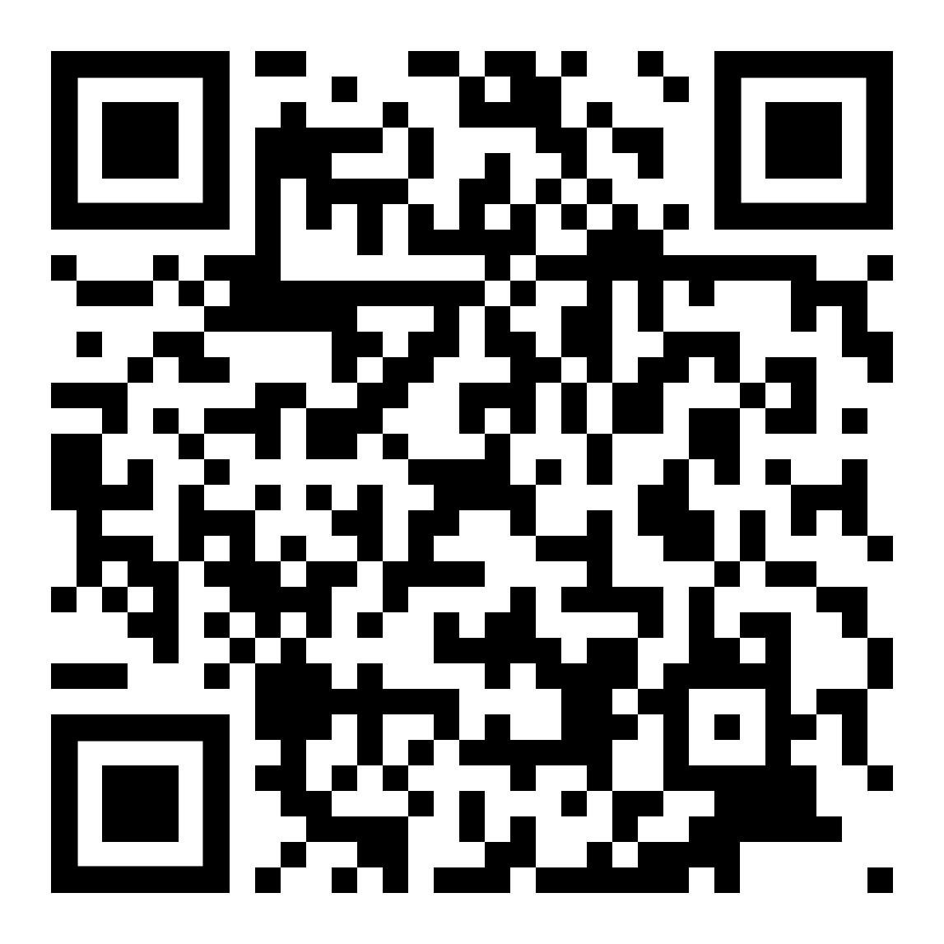
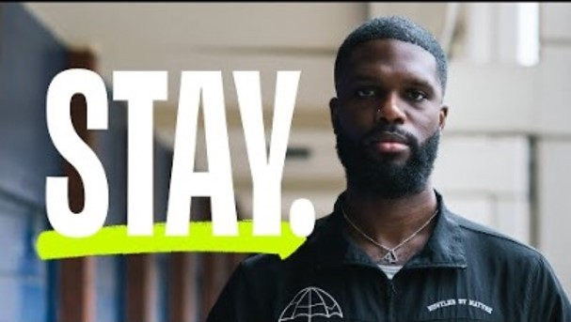
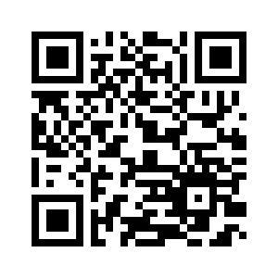
Meaning Making

Slide 6
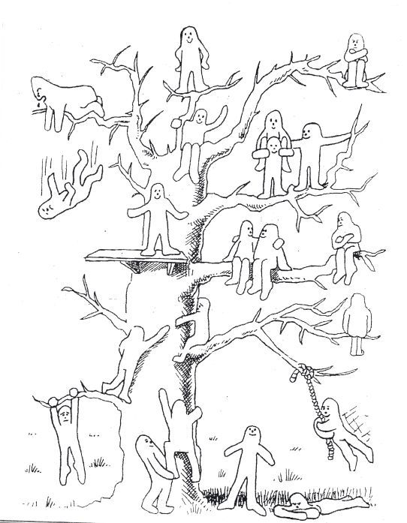
Blob tree colouring page - because self-care is important

