Slide 2
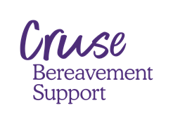
Module Two Becoming a Grief First Aider

Slide 3
Aims & Learning Outcomes Module 2
Awareness
The skills of the Grief First Aider
Group Support in the workplace
Skills
Use of counselling and communication skills
What to say, when to say, How to say, What not to say
Knowledge
The role of a Grief First Aider
The importance of communication
Peer to peer support groups – For you – For clients

Slide 4
Skills of a
Grief First Aider

Slide 5
Recap from week 1
Normalise, Signpost, Support
Remember: you are part of the decision tree:
A GFA is there to support and signpost for further support, and if required get further advice from clinical and professional organisations and signpost appropriately.
In cases of immediate harm or risk, the usual emergency service routes should be contacted immediately. (111) (Health Advice) / (999) (Emergencies / Crisis)
- Also remember to get support yourself -
Notes:
Normalise, Signposting, Support & Decisions
Emphasise throughout this training that there will be a lot of topics covered to give knowledge. The key points of this training will be:
We are going to give you the confidence, and skills that will be foundational, that you will grow into – to be able to approach and support someone who is going through, what may possibly, the worst experience to dayte in their life, that will have had an impact upon evry single aspect of their lives.
Rember – we are not her to fix – because you cannot – and that will be a theme you will become familiar with – we support through listening (the premise of the Samaritans) , ACKNOWLEDGING peoples pain and letting them sit with that pain, which is a radical act, as we all want to be fixers.
Refer back to your own workplace safeguarding policies -
To be a listener
Gain a better understanding of how to initially support in the early stages of grief, with one off support, ensuring that this is followed up with signposting or by referring to GP or emergency services if and when required.

Slide 6
Bereaved people need…
To feel their loss is acknowledged and understood
To talk to someone who is not personally involved
Someone to listen with compassion and empathy
Someone who understands the impact of grief
Signposting to practical & emotional support
What skills do I need, breakout room

Slide 7
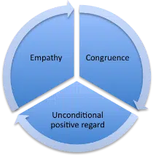
Carl Rogers' Core Conditions
The core conditions were identified by Carl Rogers who founded Person-Centred Therapy.
The core conditions are:
Empathy
Congruence
Unconditional Positive Regard (UPR)
Notes:
Basic BSF stuff

Slide 8
Empathy vs Sympathy
Notes:
The words are from a TED Talk given by Brene Brown – researcher on Shame and Guilt – prolific ted talks
Brene Showcase
https://youtube.com/playlist?list=PLmiPsabET-W_hjesjTZaITh2s1WbM-Kd0
Key messages from video:
Empathy is about connection – Sympathy drives disconnection
Empathy requires:
Understanding the other person’s perspective
Not judging
Recognising emotions (in self and others)
Communication that
Empathy is a choice to connect – means you may need to be vulnerable - recognising your own feelings
Avoid ‘At Least’ trying to make it better. Will never fix it with words - OK to say something like ‘I don’t know what to say but I’m glad you told me’

Slide 9
Communication skills

Slide 10
A master class in wordology
Notes:
Click on the text and it will play the two Ronnies. Four candles
Trainer can emphasise – question technique – clarifying and paraphrasing

Slide 11
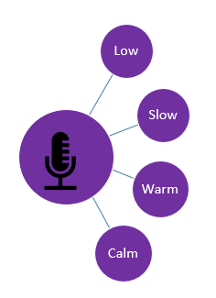
Voice
It's is our best tool....
How we say: paraverbal
Wordology: what we say
Listen
Accept feelings
Normalise
Empower
Signpost
Low
Slow
Warm
Calm
Notes:
Voice confrontation
In psychology, voice confrontation, which is related to self-confrontation,^{[1]} is the phenomenon of a person not liking the sound of their own voice.^{[2][3][4][5]} The phenomenon is generally caused by disappointment due to differences between what a person expects their voice to sound like to other people and what they actually hear in recordings.^{[2][3]} These differences arise both in audio quality, including factors such as audio frequency, and in extra-linguistic cues about their personality.^{[2][3][4]}
The two embedded audio clips will play in sequence, neither is a “Goldilocks” moment – perhaps in the middle.
Link to Guardian Article
https://www.theguardian.com/science/2018/jul/12/the-real-reason-the-sound-of-your-own-voice-makes-you-cringe
Most of us have shuddered on hearing the sound of our own voice. In fact, not liking the sound of your own voice is so common that there’s a term for it: voice confrontation.
But why is voice confrontation so frequent, while barely a thought is given to the voices of others?
A common explanation often found in popular media is that because we normally hear our own voice while talking, we receive both sound transferred to our ears externally by air conduction and sound transferred internally through our bones. This bone conduction of sound delivers rich low frequencies that are not included in air-conducted vocal sound. So when you hear your recorded voice without these frequencies, it sounds higher – and different. Basically, the reasoning is that because our recorded voice does not sound how we expect it to, we don’t like it.
Dr Silke Paulmann, a psychologist at the University of Essex, says, “I would speculate that the fact that we sound more high-pitched than what we think we should leads us to cringe as it doesn’t meet our internal expectations; our voice plays a massive role in forming our identity and I guess no one likes to realise that you’re not really who you think you are.”
Indeed, a realisation that we sound more like Mickey Mouse than we care to can lead to disappointment.
Yet some studies have shown that this might only be a partial explanation.
For example, a 2013 study asked participants to rate the attractiveness of different recorded voice samples. When their own voice was secretly mixed in with these samples, participants gave significantly higher ratings to their voice when they did not recognise it as their own.
What’s more, a complete explanation can be found in a series of early studies published years before the plenitude of reports offering the sound frequency and expectancy explanation.
Through their experiments, the late psychologists Phil Holzemann and Clyde Rousey concluded in 1966 that voice confrontation arises not only from a difference in expected frequency, but also a striking revelation that occurs upon the realisation of all that your voice conveys. Not only does it sound different than you expect; through what are called “extra-linguistic cues”, it reveals aspects of your personality that you can only fully perceive upon hearing it from a recording. These include aspects such as your anxiety level, indecision, sadness, anger, and so on.
To quote them, “The disruption and defensive experience are a response to a sudden confrontation with expressive qualities in the voice which the subject had not intended to express and which, until that moment, [s]he was not aware [s]he had expressed.”
Their following study showed that bilinguals who learned a second language after the age of 16 showed more discomfort when hearing their recorded voices in their first language – a fact not easily explained a lack of bone-conducted sound frequencies.
The complexity of vocal coordination is enormous and we simply don’t have complete, conscious, “online” control. Indeed, the vocal larynx contains the highest ratio of nerve to muscle fibres in the human body. Moreover, when hearing a recording, we have none of the control of our speaking that we usually do; it’s as though our voices are running wild.
Marc Pell, a neuroscientist at McGill University, specialises in the communication of emotion. He stands by the Holzemann and Rousey studies, saying: “when we hear our isolated voice which is disembodied from the rest of our behaviour, we may go through the automatic process of evaluating our own voice in the way we routinely do with other people’s voices … I think we then compare our own impressions of the voice to how other people must evaluate us socially, leading many people to be upset or dissatisfied with the way they sound because the impressions formed do not fit with social traits they wish to project.”
So, even though we may be surprised by the “Mickey Mouse” quality of what we actually sound like, it is the extralinguistic content of what our voices may reveal that could be more disconcerting. Yet it is unlikely that others are similarly surprised by a high-pitched aspect of your voice, and moreover others probably aren’t making the same evaluations about your voice that you might. We tend not to be critical of other people’s voices, so the chances are you’re the only person thinking about your own.

Slide 12
Effective communication
Face-to-face, feelings driven & emotional conversations
Verbal
What we say
Para-verbal
How we say it
Non-verbal
Expressions
Language,
Gestures, everything else!
Notes:
Trainer to ask the question about what percentage does verbal, para-verbal and non-verbal play a part in us getting our message through to someone.
Ask this question before you disclose the pe chart percentages
Hold a group chat – EMPHASIS – This was a small study and is relevant to F2F
https://www.bl.uk/people/albert-mehrabian#:~:text=Drawing%20on%20the%20combined%20findings,liking%20%2B%2055%25%20facial%20liking.
Professor Mehrabian (1939-) believes that there are three core elements in the effective face-to-face communication of emotions or attitudes: nonverbal behaviour (facial expressions, for example), tone of voice, and the literal meaning of the spoken word. These three essential elements, Mehrabian argues, account for how we convey our liking, or disliking, of another person. His particular focus is on the importance of such nonverbal ‘clues’ when they appear to conflict with the words used and/or the tone in which they are spoken. Mehrabian developed his early theories on this subject during the 1960s. Drawing on the findings of two experiments he conducted in 1967, he formulated the 7-38-55% communication rule.

Slide 13
Communication medium
Face to Face
Telephone
Group
Remote working
Notes:
Explore the different implications – Breakout room if time allows – 4 groups (min three per group)
Face to face – practical considerations – room layout – needs – etc
Safe space – a space some one can access at work – to receive calls – EA progs – or to break down for a moment
Groups – conducive space – privacy etc
remote working – Consider – remote worker may now be home alone – struggling – isolated
Develop

Slide 14
Questioning Styles
Open
Closed
Probing
Paraphrasing/ Reflecting
Hypothetical
Leading
Encourage
Gather
WWWH -W?
Awkward
1-Sided
When?
Clarify
Rapport
-Interrogate
Reflecting
Check
Understanding
Gauge
Possibilities
"if"
Imply
Right
?
Focus
Elicit
Encourge
Notes:
Open questions are commonly used to encourage the other party to open up, so that you can gather the necessary information.
They often start with what, where, which, how. why,
You will find that they work best when the conversation is already flowing freely. For example:
'How did that work out for you?' 'What did you do to keep yourself safe?' 'How would you respond to that if it happened to you?
Closed questions require a 'yes' or 'no' answer. Such questions should be used sparingly because they tend to make any conversation feel awkward and one-sided, but in some instances an affirmative or negative answer is all that is needed. In sensitive situations, they are best avoided as they can harm the rapport and empathy that are an essential part of active listening.
Probing questions can be used to clarify something that has already been said or to find out more detail about it. Many of them are helpful in creating rapport, but you must take care not over-use them as this can make people feel as if they are being interrogated or even attacked.
Make sure your verbal and nonverbal signs are neutral or supportive when asking such questions. This type of question is useful in uncovering details that may have initially been overlooked or thought irrelevant. For example:
'Why do you think this is the case?' 'What does that mean?' 'What are your options for solving the problem?' 'Could you be more specific?' 'Who is involved? Who are the key stakeholders?' 'What needs addressing?
Paraphrasing / Reflecting questions are one of the best ways you can check your own understanding of what the speaker has said. For example:
Speaker - 'I can't cope any more, no one listens and if they do they seem to be in a rush, don't know what to say and gloss over my feelings quickly moving on.' Listener - 'I'm hearing you say that you feel people are not making time for you top tell your story and be heard.
Reflective questions are frequently used to check and clarify your understanding. This style of question reflects back to the speaker what they have just said and allows them to fully explore their knowledge of a situation.
These questions also provide an opportunity for the other person to give voice to the emotions they felt at that particular time without you having to interpret why this happened in your question. Use of reflective questions dispenses with you having to express an interpretation or judge why the other person felt this way. For example: Speaker - 'I feel frustrated with myself.' Listener - 'And what is this "frustrated with myself" experience like?'
Speaker - 'Those people in dispatch are always messing me about.' Listener - 'What does that "messing you about" behavior involve?'
Hypothetical questions allow you to gauge how someone might act or what they think about a possible situation. They are effective in getting the person to think up and discuss new ideas or approaches to a problem. For example: 'What would you do if…?' 'What would happen if…?'
Leading questions need to be used with care because they imply that there is a right answer to the question, which contradicts the ethos of active listening. They are useful in situations where you require a desired answer or need to influence people's thinking. For example: 'So wouldn't it have been better to…?' 'Don't you think we should have…?’
A leading question is a type of question that prompts a respondent towards providing an already-determined answer. This type of question is suggestive as it is framed in such a way that it implies or points to its answer(s).

Slide 15
Non-verbal skills & your environment
S
O
Sit
openly
L
Lean towards client
E
Eye contact
R
Relax
Sit
squarely
Notes:
https://www.stockton.ac.uk/media/3545/the-soler-model-script.pdf
SOLER stands for • Sit Squarely • Open Posture • Lean forward • Eye-contact • Relax Let us have a look at these in more detail: Sit squarely. Sitting, as opposed to standing is a vital first step. You need to be on the same level as the person you are talking to, so that you don’t appear to be towering over them, as if you are trying to assert a dominant position.
Try to position your body so that there is enough of you facing the client, making you seem open and attentive, but no so straight that you might appear intimidating. This is not a staring match! Open posture. Body-language experts often claim that crossed arms and legs can be a sign of hostility or conflict.
Keep your body “open” to avoid appearing defensive. Lean forward. By leaning towards the service-user, you are showing that you are interested in them and what they have to say. By contrast, leaning back can make you seem distant or uninterested. Of course, you should be careful not to lean too far forward, so that you do not invade personal space.
Eye-contact. Egan stresses the importance of using eye-contact to show interest and attentiveness towards the other person in the conversation, while also finding a balance, so you do not end up staring. However, you must remember that in different cultures around the world, making direct eye-contact can signify very different situations.
So, while you may be trying to be interested, caring and attentive, people from different backgrounds may interpret this as anger, aggression, or establishing a hierarchical status. Considering the cultural background of your service-users is another important factor of person-centred care. Relax. By showing relaxation in your body language, you are showing the service-user that you have time for them, and you are not in a rush to leave. It can also convey confidence, which can further put your service-user at ease, as they feel they are being listened to, respected, and well cared for.
Use this moment to discuss suitable locations for support
Privacy
Tissues – GO BAG
Time – allow enough time if you are offering support – not squeezed in

Slide 16
Skills practice Goldfish Bowl
Notes:
Practice questioning technique
Trainers could role play
Trainer to introduce themselves as Bob – EITHER
Remain in one room or spilt into two groups – pref – 1 room – either trainer picks up the questions that are presented – offer enough of an answer to spur more questions – answer closed questions – closed.
Trainer tells a story from the GFA character – they use pre suggested different questions – to extract the story
Add in some complications and considerations – zoom- telephone in person

Slide 17
What to say
Notes:
Group discuss – whiteboard- scene setting
TRAINER TO ACKNOWLEDGE – THIS TRAINING IS NOT ABOUT GIVING YOU A SCRIPT – IT IS ABOUT AWARENESS BUILDING
Often you can say the wrong thing, and it’s ok, if said with the right intention.
There is no script, everyone will grieve and react differently, this is what we will continue to explore

Slide 18
What to say, or not to say
Patch
Notes:
https://vimeo.com/791591605?share=copy
As with all the video material – let the delegates know that we will be asking everyone for just one takeaway point- lightbulb moment.
Trainer to bring out – being genuine and displaying empathy, less is often more – no right or wrong way.
Transcript
Carry our own death anxiety and that awkwardness around us it comes from a good place we don't want to make things worse for people were afraid to say the wrong thing but unfortunately we all do out of our fear saying the wrong things sometimes we stay nothing and at least bereaved people feeling unsupported and they do notice when you hop into a shop door provide them across the street those are the hurtful things that people in bereavement talk about if we were to keep it very simple I'd say acknowledge the grief just acknowledge it's a message to the other person that says I'm sorry that this happened to you it won't have to make it fancy you don't have to come up with something that's going to make them feel better the message between you is just I care that this happened so we are old Irish one is I'm sorry for your trouble it's actually quite hard to improve on it's just an acknowledgement these in person or a personal dropped in the drawer or something that said at the funeral it matters to breathe to people it's already such an isolating experience it really matters that other people show so show up and acknowledge it and then stay away from your own story we get kind of activated sometimes and talking to someone that's being breathed it makes us think of our own losses and before we know it we're telling our own story most bereaved people early agreement will need to hear about our stories they just need to know that you care we should write a book and some of the worst things that people say if I was to say it in short add say anything that starts with the phrase at least things welcome when bereaved people say at least when they come to that it often means they're starting to get a handle on their grief you know so if breathed person says well at least he didn't suffer or it's better you know that I went that he went before me he wouldn't be able to manage thousand that's believed people started to grapple with their grief who we as supporters are saying at least I think we minimise the grief we're not getting us it's not your job to try and make the person feel better and so I'd say don't don't say anything that starts with at least don't tell stories about grief either you're on our I know a fellow had is worth anything like that is kind of our all activation show and shorter and just support if you don't know what to say just say that I'm so sorry I don't know what to say how are you today can I do for you today and simple practical things sometimes they don't feel kind of highfalutin enough for us but actually bring it over a home cooked meal and leave it not on your best China that should be looking for it back but just a simple dish that's that saves them having to put up a meal and maybe they eat something nutritious definition that is good grief support and there's no mad rush you know for people who've had a significant bereavement this is life changing this is going to go on for a long time stop with plenty time you can pace yourself a lot of grief people will say there's the mad rush of everybody in the first month and but then they face into the first Christmas the 1st birthday other anniversary 's that people might not know about if you're serious about supporting your friend as you said trying to be there over the long haul.

Slide 19
What to say/not say…
It must be a relief that your mother is no longer suffering
You poor thing. I can’t imagine how I would feel….
I am sure it will get easier. Time is a great healer
I am sorry but I just don’t know what to say
When my … died a few years ago I felt…
I understand that … passed away recently
I’m sorry to hear about… but at least he had a good innings
I know just how you feel
Notes:
When we do work with people outside of Cruse – businesses, other charities and local authorities, the thing people want to know is “what do I say to a bereaved person?” (and what should I not say?)
Here are some sample phrases – some good and some not so good.
Consider asking the audience if they have a phrase that they find they use? Or which ones on the slide do they feel might be suitable?
The most important thing is that you say something and don't avoid the topic
Acknowledge the death – and find some words that come naturally to you. It can be as simple as “I’m so sorry to hear your news”
Don’t offer advice
Don’t assume you know how they feel, even if you had a very similar experience yourself _ TOP TRUMPS
Avoid the standard phrases about time being a healer – you may mean well but they probably won’t feel like that –
Bereaved people want to be truly listened to. Taking the time to listen and having a compassionate approach is a really good start.
It is always better to say something than nothing and if you think you are saying the “wrong thing” just stop. Most bereaved people will understand that you were trying to say something suitable.
But untimely, no one can “fix” this. There are no “right” or magic words.

Slide 20
Skills Practice 1-1
Notes:
One to one – create as many breakout rooms as needed. – pair everyone up – encourage them to tell a story about theor week – add feeling and emotion to the story but keep it light – the listener is to use the various questioning techniques to gain a fuller understanding of the story – 5 mins each

Slide 21
Peer Support Groups
Notes:
Two aspects – the GFA facilitating a group for people who are bereaved
And support for fellow GFA’s
Open up to the clients – can you imagine a scenario where a pop up group may happen at yours
The reason we are “educating” about support groups as they may be an option, especially if there are existing support groups on-site already, or naturally formed groups that can have a GFA drop-in and contribute.
We are also recognising the fact that there may be extensive facilitation skills already present within the skillet of the GFA delegate.
Examples to be drawn out
Campus – University – groups will already be established – residence, class, sports etc
Workplaces that have teams – sales, project, IT – Microsoft TEAMS is a real example – people are part of teams, physically or virtually
Team orientated environments – Sports organisations, MOD, - workplaces where teams are the focus. In these environments there will be plenty of facilitators.
Cruse per see – can offer specific group facilitation skills – Cruse have this for UYBO and a group facilitation course for supervisors.
For the GFA – we now have the untangle app which will provide peer-peer support groups for the GFA and also support groups for the bereaved clients of the GFA if appropriate
Joining a support group can be an intricate component for healing and finding comfort following the death of a loved one.
Don't let not knowing what to expect keep you from this valuable resource. A sample group session may help you become more comfortable in this setting.
They can be created for specific events, or part of the company or university campus
Types of Grief Support Groups
Support groups fit into two categories: open and closed groups. An open group comes with no attendance commitment and doesn't have a finite start or end. These groups allow participants to drop in at any point and include people at different stages of grief. Closed groups feature a specific curriculum that lasts a definitive amount of time, usually six or eight weeks with one meeting per week. These groups focus on specific topics related to grief or types of loss and require all participants to begin at the same time. Both group formats can include structured activities like watching films on relevant topics and completing in-group assignments. Either type of group could also be unstructured where the facilitator asks participants to discuss any topic on their mind that day.
https://www.lovetoknow.com/life/grief-loss/sample-grief-group-session
Open Group Session Structure
Groups are held in churches, hospitals or other public locations with intimate meeting rooms and are generally free. Meeting times are posted in a public format tell you what type of group it will be. The American Psychological Association (APA) says a typical group session lasts one to two hours and occurs on a weekly basis. Psychologist Carrie Hill shares typical structure of a grief group session may include pre-meeting mingling, a loosely structured format, and post-meeting mingling. Since each group is unique, the structure will vary, but most include these basic elements.
Welcome and Announcements
While seated in a circle, the group leader or facilitator welcomes everyone then explains the group's purpose, ground rules and structure within the first five or ten minutes. He will go over meeting dates and times so you can jot them down if needed. This is a great time to ask questions about attendance, potential topics or other information you'd like to know. In some groups, this information will be presented in every successive session if there are new group members.
Introductions
The facilitator may ask participants to go around the circle and state basic information like their name, where they're from, who they are grieving the loss of and what they hope to gain from the group. Anyone who doesn't want to share details can state her name and pass to the next person. Some people will have a lot to share while others may not be ready to open up.
Call for Conversation
Once everyone is acquainted, the facilitator may introduce a topic then ask for volunteers to share relevant personal experiences. Other times the facilitator will open the floor for discussion and ask for a volunteer to share anything that's on his mind. After the first person shares, others can jump in and offer words of support or start speaking about their experiences as they relate to the last person's. This part usually lasts up to forty minutes in a one-hour session. Depending on the specific type and format of the group, topics cover a wide range of emotions and personal experiences. Some common grief support group topics include:
Handling the holidays or other special occasions
What to do with the loved one's possessions
Meaningful rituals to keep the deceased's spirit alive
Establishing memorials like gardens or online websites
Handling coworkers and family members
Dealing with depression
Reinvesting in life
Coping with change
Understanding emotions and the grief process
Closing the Group
For the last ten minutes, the facilitator may recap the overarching themes of that day's discussion. She may also take this opportunity to hand out or mention resources related to the discussion such as other groups, organizations or recommended reading. Some groups end each session with a ritual such as a phrase like "let the healing continue" or something more physical, like a group hug.

Slide 22
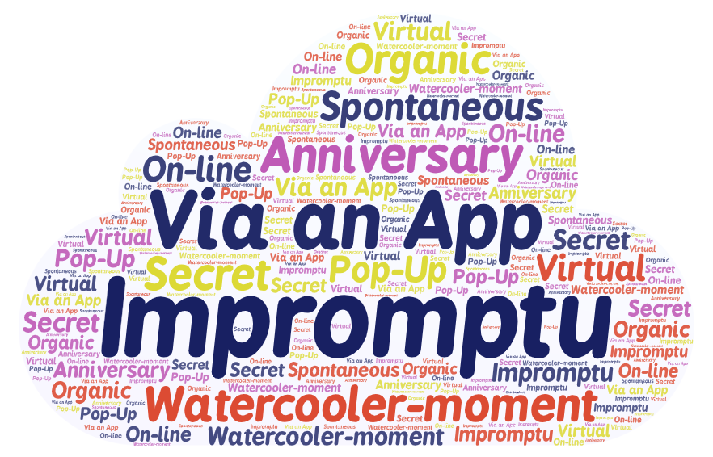
It could look like...
Notes:
Death in the workplace
Trainer to discuss and build the impact of a death in the workplace / open up discussion.
Long term implications of a death of an employee
Communicating the news of a death in a sensitive way
Impact upon business
Impact upon relationships within the business
Things to avoid
Developing a strategies
Condolences
Time off
Responsibilities
Death of a colleague
Considering feelings (disenfranchised etc.)
Impromptu – piggyback event
A watercooler moment
Anniversary
Spontaneous
In the moment
Grown organically
Created without you knowing
May be “pop-up” or 1-off
Incident / anniversary driven

Slide 23
Peer to Peer
Notes:
23
Peer to Peer Support
Video from YouTube
Jasmeil https://youtu.be/5UOsqcl2nA4
Scott : https://youtu.be/cGN4NNszscw
What makes Peer Support Unique : https://youtu.be/OH1YRcf3UAA
What makes Peer to peer support unique – Vimeo. : https://vimeo.com/743332077/ab3151d31a
Attribute
Scottish recovery network
https://www.youtube.com/c/ScottishRecoveryNetwork

Slide 24
Characteristics of a support group
Open format
Safety & confidentiality
Ad-hoc people & agenda
Open to new people
Conversational
No formal structure
Lighter conversations
Closed format
Start and end dates
Cannot join after start date
More structured
Present an agenda
Psych educational
Potentially more emotional
Peer group bonds established
Notes:
Open format – topical conversations may happen
What to do with the loved one's possessions
Handling the holidays or other special occasions
Meaningful rituals to keep the deceased's spirit alive
Establishing memorials like gardens or online websites
Handling coworkers and family members
Dealing with depression
Reinvesting in life
Coping with change
Understanding emotions and the grief process
Closed Group Session Grief Support Curriculum for Adults
Image Credit
In a closed group, participants receive more information and resources in the form of presentations during each session. The group follows a specific theme and curriculum tailored to fit the needs of participants. Most elements are the same as an open group, however, the major difference is the bulk of time in a closed group session will be spent watching presentations rather than having an open discussion.
Welcome and Announcements
Participants sit in a classroom setting where they all face the front. The facilitator welcomes members and introduces the themes, structure and ground rules for the group. This may take ten or fifteen minutes as the facilitator will only present this information during the first session because all participants begin on the same day.
Introductions
Group member introductions may only take place during the first session because the expectation is everyone will start on this day and attend each subsequent meeting for the allotted time frame. The facilitator may ask each person to share his name if she's attended a group before and what type of loss she is grieving.
Presentation of information
Participants may watch a video, listen to a speaker, take part in role-play scenarios, complete work sheets and journal entries or engage in other activities related to the presentation of information by professionals on specific topics. This part of the session may take up to half the time in a one-hour group.
Open Discussion
Open discussions take place after hearing educational information and relate to the topic presented. There may only be about twenty minutes for discussion time in a one-hour group.
Closing and Homework
In the last five minutes of a session, the facilitator may present group members with an assignment to work on before the next group session. Homework assignments may include journal entries, exploring other resources or more active and emotional tasks like sorting through a loved one's belongings.
Support Group Atmosphere
In a group, you want to feel comfortable sharing, crying and talking. Grief groups don't promise to help people stop grieving, but to help people meet others who understand their feelings as a way to normalize the individual grief process says the National Association of Social Workers (NASW). Others in the room are like you; they have lost a loved one. Some may want to talk, others will only cry. The atmosphere is nurturing and warm. Attendance is a choice and some people attend for months or years while others find they need to only go a few times.
Role of the Facilitator
A good facilitator, or leader, is empathetic. This person may have lost a loved one or has experience dealing with the emotions related to grief. The NASW points out facilitators don't have to be professionals, but should at least be:
Aware of community resources
Knowledgeable about the grief process.
Warm, compassionate, friendly and caring
Able to guide group discussions
Have resources to provide useful, factual information
The facilitator should also actively be making sure everyone respects the boundaries of the group.
Role of the Participant
Each participant has experienced a loss and is looking for support and understanding from others. There isn't a wrong way to participate in a support group. The APA suggests an ideal group size is from six to fifteen participants. Smaller groups offer more individual attention while larger groups create more diversity and offer participants a wider range of examples to see how others are dealing with grief. Participants should all feel free to:
Share personal feelings and stories
Cry and express other emotions like anger or frustrations
Remain silent and listen to others' experiences
Ground Rules for Support Groups
In order for a support group to be successful, all participants, including the facilitator, must agree to follow specific guidelines to keep others feeling safe. All members of grief groups should aim to:
Be on time
Refrain from starting side conversations or taking phone calls in the group
Keep all shared information confidential
Listen actively when others speak
Refrain from arguing or making offensive comments
Respect the opinions of others and reserve judgment
Limit time speaking to give everyone a chance

Slide 25
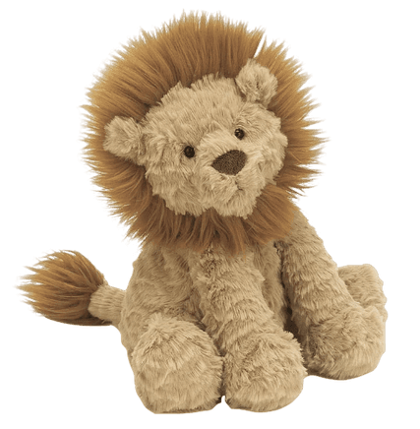
Personality types
The Animal model
Traditional
Dominator
Gladiator
Joker
Educator
Revealer
Solver
Otter
Lab
Beaver
Lion
Notes:
There are many models that have been created to try and label different people, in the workplace ( Myers and Briggs – ENTJ ) - , in life and society in general.
This example is a more fun one – Please look to your handouts and choose which kind of animal or hybrid animal you can relate to, or even better – make one up yourself –
Empahise – It is important to know that you may indeed have a good understanding of a colleague's personality type – Sales – HR – Engineering _ Admin – if we close our eyes we can see typical characteristics of that person, extrovert, introvert, attention to detail person, a quiet demeanor.

Slide 26
Small Group Personalities
Strengths— Calm, easy-going, dependable, quiet, objective, diplomatic, humorous
Weaknesses— Selfish, stingy, procrastinator, unmotivated, indecisive, fearful, worrier
Otter
Strengths— Outgoing, responsive, warm, friendly, talkative, enthusiastic, compassionate
Weaknesses— Undisciplined, unproductive, exaggerates, egocentric, unstable
Lab
Strengths— Visionary, practical, productive, strong-willed, independent, decisive, leader
Weaknesses— Cold, domineering, unemotional self-sufficient, unforgiving, sarcastic, cruel
Strengths— Analytical, self-disciplined, industrious, organized, aesthetic, sacrificing
Weaknesses— Moody, self-centred, touchy, negative, unsociable, critical, revengeful
Lion
Beaver
Notes:
Walk through the model – draw out the fact that we are all different, the human condition wants us to label everything
THE BIG TAKEAWAY POINT IS – THAT WE ALL KNOW THE OFFICE / CAMPUS PERSONAILITIES – YOU MAY BE ONE OF THEM – BUT - THE SIMPLE TRUTH IS – THE MANIFESTATION OF GRIEF WILL DOMINATE ANY PERSONAILITY TRAIT AT THE MOMENT YOU ARE INTERVENING.
There are acknowledged way to help counter and facilitate different characteristics, that will not be covered in depth on this course, there are references to resources in your handouts.

Slide 27
How grief may actually manifest in a group
Emotionally RAW
Crying, Loud, Sobbing, Distressing
Desperate
Excessive Need for Attention, Cutting people off, Overtalking, Dominating, Alienating others
Avoidant Coper
I know better, Dismissive of others
Bewilderment, Confusion, Anger, Snappy, Boredom, Frustration, Cultural Disagreement, Boredom, Frustration, Cultural Disagreement
Traumatised
Complex Grief
Poor Mental Health
Silence, Camera off, Quiet
May not have filters when talking to others
Notes:
Facilitating a group is a skilled role, one that we would recommend further training. Cruse offer a course and soon the martin and Kirsty show will as well :-)

Slide 28
Death in the workplace
Notes:
Purpose – Peer to Peer support for the bereaved and the GFA
The app is directed to provide resources and support to the bereaved by a variety of methods. Group discussions, mindfulness events, direct support, signposting and resources.
For the GFA’s, there will be a closed support group where they will be supported in their role.
Have you own support groups internally – especially if multiple GFA
If not – your peers in this room – whatsapp – facebook groups

Slide 29
Impact of a death in the workplace
Death of colleague can leave a professional and personal gap
Come together to acknowledge loss & discuss support
May impact your work – emotionally and physically
May remind you of your own losses
Be kind & patient with yourself
Difficult triggers
Clear their desk, delete electronic references to them, advertise their role, taking calls for them…
Talk with colleagues – share feelings and memories
Seek help when needed
Find ways to remember and honour them

Slide 30
Support for the GFA
Notes:
Exercise – what support do you think you would need / like / want
Purpose – Peer to Peer support for the bereaved and the GFA
The app is directed to provide resources and support to the bereaved by a variety of methods. Group discussions, mindfulness events, direct support, signposting and resources.
For the GFA’s, there will be a closed support group where they will be supported in their role.
Have you own support groups internally – especially if multiple GFA
If not – your peers in this room – whatsapp – facebook groups

Slide 31
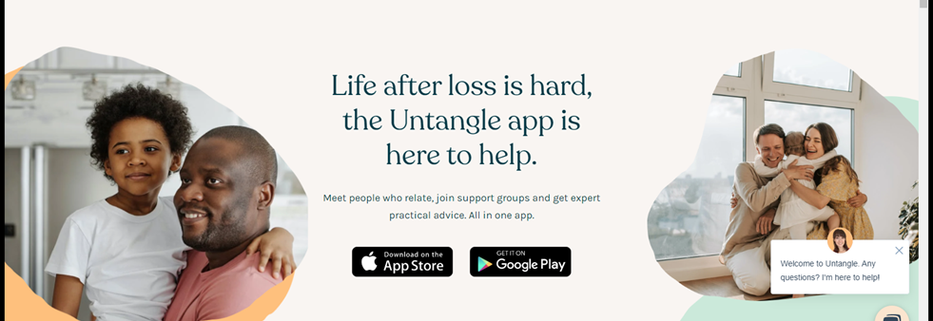
Peer support for you
Notes:
Trainer shar escreen for GFA micro site – instructions for the Untangle APP will be there
Private closed support space for people who have completed the GFA training
Highlight
The relationship is new with Untangle and Cruse
The community is growing
It is a subscription app but free to you
There are trainers in the priate space
Be aware
The app has monitised resources in there and large grieving communities – be awre of your exposure
Do not feel you need to be a GFA for the people in the app – approach with a balance

Slide 32
How has today started to shape your GFA personality?
Notes:
We are drawing out of the delegate – what they learned – personal to them and their workspace – so we will see what has stuck – we will also see what is missing – and we will also see anything that wrong , like advice giving, fixing, and we can nudge in the next session.
We are defining the role by their learning experience – wax on wax off – they are learning that will be there to draw upon when needed – learn the form to forget the form or Carl Yung says – learn and then set it aside.

Slide 33
Checkout
Notes:
To be decided

