Slide 1
23Sept

Slide 2
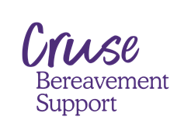
Module Three Difficult subjects, Signposting and Support.

Slide 3
Aims & Learning Outcomes
Awareness
Trauma
Impact of being bereaved by suicide
Additional resources and support for grief support
How to implement the Grief First Aider role in your workplace
Skills
How to identify traumatic loss and signpost
How to support
Signposting
Bringing it all together in your workplace

Slide 4
Self-awareness

Slide 6
Exercise – Your own mortality
Notes:
In pairs – chat about what plans you have made.

Slide 7
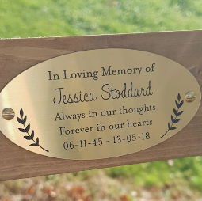
What types of reflections arise when talking about dead, death and dying?
Am I ready?
Policies
Life assurance
Will
Funeral arrangement
Looking after your pets
Legacy monuments

Slide 8
Signposting & Support
Notes:
Anyone that has had a bereavement, can call the helpline, they will get emotional support, the most up to date signposting and, if available a referral to branch.

Slide 9
Cruse.org.uk
0808 808 1677

Slide 10
Specialist sites
Cruse Bereavement Support: www.cruse.org.uk www.hopeagain.org.uk
WAY Widowed and Young: www.widowedandyoung.org.uk
Samaritans : www.samaritans.org.uk
Winston’s Wish: www.winstonswish.org.uk
Grief Encounter: www.griefencounter.org
Many more organisations: www.cruse.org.uk/organisations/signposting

Slide 11
Trauma
Notes:
Andy L comments
If symptoms of trauma are present – GFA’s need to signpost to employee assistance programme and the GP ( GP only if no EAP)
Symptoms of trauma cannot be managed safely within the GFA and client relationship.
Emphasise
As a GFA we are not diagnosing / managing any condition, mental health/trauma etc.
As a GFA we do not connect the dots, we facilitate the client connecting dots. Signposting is key.

Slide 12
Trauma
Notes:
Trauma
Bring back to the workplace -
https://youtu.be/v60Pi87sqhI
Moments in life that test us and challenge our sense of safety = natural, human,
Come from no where – trauma comes in many forms – ripple effect – significant loss – event – Manchester arena
Most people it passes with time – sometimes not
Fear sadness guilt and anger – all common – but prolonged – leaves you exhausted
Effects of trauma can creep into everyday life – sleep – alcohol other drugs
People feel like they are not making progress – overwhelmed – trapped – family may feel helpless
We may simply signpost

Slide 13
The impact of sudden and traumatic death
What is sudden and/or traumatic death?
Even death by ‘natural causes’ can be traumatic for the bereaved
Characteristics of sudden or traumatic
Involvement of medical / legal authorities can impact grieving
Notes:
Heightened emotion – anger, guilt…
Greater sense of disbelief
Loneliness and isolation more likely
Need to blame someone or something
World as we know it feels changed forever
Sense of pointlessness / hopelessness

Slide 14
Secondary trauma
Notes:
Vicarious Trauma

Slide 15
We all have a window of tolerance
Signs of Distress
Hyper-arousal
Signs of Distress
Hypo-arousal
I am Okay
Numb, zoned out
Feeling empty
Cannot think
Cannot connect
Lethargic
Unmotivated
Depression / Fatigue
Disorientated
Fast heart rate
Reduced appetite
Tummy ache
Sweat, shake
Hyper-vigilant
Fight / flight
Run, hit, shout
Avoid or Disrupt
Heightened anxiety
Difficulty focusing
Fast heart rate
Reduced appetite
Sweat, shake
Hyper-vigilant
Rapid speech
Panic attack
Hyper-ventilating
Optimal Functioning
Where growth happens
Be careful
Be careful
I am Not Okay
I am Not Okay
Notes:
Aim: To raise awareness of the Windows of Tolerance Model
Window of Tolerance
Handout 5: Window of tolerance
In the optimal zone, we can love, relax, learn etc.
For someone coping with a traumatic stress reaction, even small everyday events can push them out of their window of tolerance towards distress, everything can seem more intense
HYPER AROUSAL REACTION – THE USUAL
Reactions are usually hyper-arousal (fight, shout, not being able to relax or concentrate, having no sense of head space) or
HYPO AROUSAL
hypo-arousal (being over-tired, not having any energy, feeling numb or shut down, not being able to think clearly)
These reactions are both survival modes, they are a dysregulation indicating a trauma response, as opposed to being disruptive or deliberately unhelpful, and must be framed this way for the client
Trainer to point out that either distress response may be evident in a session, e.g. a client who is walking about, making a cup of tea etc. during the session (hyper-arousal) or a client who seems numb, slow, tired (hypo-arousal) and it is important to see either behavior as a response to trauma as opposed to it being an issue with the client having poor boundaries etc.
On the helpline – you have less visuals

Slide 16
The biology of trauma
Notes:
https://vimeo.com/user207261572/biology?share=copy
https://vimeo.com/elephantsinrooms/limbic?share=copy edited version
Remind trainees that the client’s response to trauma will be automatic as opposed to consciously chosen and that they may well find it hard to engage with the trauma in a cognitive, thinking way – there may be times when they are in the overwhelm and can only react to it.
We will be dealing with clients who have had traumatic bereavements, (e.g. homicides, suicides, road deaths) which are non-related to the Coronavirus situation, and who may be dealing with fight or flight responses. We will also we dealing with clients who have experienced loss due to the Coronavirus, and that may be more likely to engender more passive responses due to helplessness, e.g. of not being able to visit the person in hospital.
https://youtu.be/5CpRY9-MIHA – dan Siegal Hand model of the brain
PPT 8 Dan Siegel’s ‘Flip Your Lid’ video
The video is available at: https://www.youtube.com/watch?v=gm9CIJ74Oxw
Have this ready as a ‘file to share’ and upload here
Remind trainees that the client’s response to trauma will be automatic as opposed to consciously chosen and that they may well find it hard to engage with the trauma in a cognitive, thinking way – there may be times when they are in the overwhelm and can only react to it.
We will be dealing with clients who have had traumatic bereavements, (e.g. homicides, suicides, road deaths) which are non-related to the Coronavirus situation, and who may be dealing with fight or flight responses. We will also we dealing with clients who have experienced loss due to the Coronavirus, and that may be more likely to engender more passive responses due to helplessness, e.g. of not being able to visit the person in hospital.

Slide 17
Trauma and Recovery Model by Judith Herman
Safety
Remembrance and Mourning
Reconnecting
Notes:
In trauma the grief and loss is to do with the loss of life being as it had, of having a sense of control, power, autonomy in our lives which has now been profoundly shaken.
Safety – this is the first focus on working with a traumatic event because the event will have robbed the client of their sense of power and control. It is an essential stage before beginning to consider grief support, as the client may still be in survival mode. A safe environment , a safe therapist, they have to feel safe. Once we have been hurt we want to isolate ourselves, through that process we regain the feeling of being safe.
Remembrance and mourning – the need to grieve for how things were before the traumatic event occurred will be mixed with the need to grieve for the bereavement too. The survivor tells the story of the trauma, a reconstruction, entering into the lifes story. The basic principle of empowerment is still key, it’s a choice for the survivor to revisit and speak
Reconnecting – growing around grief of the trauma. Introduce the idea of Post Traumatic Growth, where adversity and the courage and capacity to deal with it, can result in positive psychological change and a higher level of functioning than before the traumatic event occurred. The survivor now faces the fact that they must have to face the future, and they are changed by the loss/trauma.
https://youtu.be/39Msj88OQJ4. - The three stages of recovery – black and white powerful vlogcast
1st principle – empowerment of the survivor – no intervention that takes away power from the survivor will help, the survivor needs to take back the power
3 stages central tasks as above, not linear, its an attempt to impose simplicity over a turbulent and complex situation
Kubler ross 5 stages of grief – not linear example.
Unpredictable reliable safety
Complex disorders need complex and comprehensive treatment. Treatments should be relevant and applicable at each stage, what may be right at one point, may not be at another.

Slide 18
In Practice
Notes:
ALLOW THIS VIDEO TO SINK IN
FOCUS ON THE WAY THIS LADY – HAS / IS EXPERIENCING TRAUMA – AND BUILDING UP TO DEALING WITH IT IN SUCH A PUBLIC MANNER – WITH A FILTER – WOW MOMENT – THE LINK BELOW SHOWS HER UNMASKED IF THE GROUP ENGAGE.
https://vimeo.com/user207261572/judith?share=copy

Slide 19
Help Understanding Grief by Suicide
Notes:
INTRO – BEREAVED BY SUICIDE OR WITNESSING A SUICIDE – HAS UNIQUE, AMPLIFIED CONSEQUENCES IN THE WORKPLACE
YOU ARE MORE LIKELY TO GET A BUNCH OF FLOWERS FROM THE WORKPLACE OR NEIGHBOURS IF YOUR DOG HAS DIED, THAN IF A FAMILY MEMBER HAS COMPLETED SUICIDE
STIGMA – A MANIFESTATION OF THAT – PEOPLE LITERALLY CROSS OVER THE ROAD – THEY ARE TRIGGERED – THEY CANNOT COMPREHEND WHAT SUICIDE LOOKS LIKE, ESPECIALLY IN THEIR OWN LANDSCAPE – THEIR ASSUMPTIVE WORLD HAS NOT BUILT IN THAT CALCULATION
What is suicide?
Suicide is when someone intentionally ends their own life.
What are suicidal thoughts?
Suicidal thoughts or suicidal ideation means thinking about or planning suicide. Thoughts can range from a detailed plan to a fleeting consideration.
What are some of the common myths about suicide?
Myth
Talking about suicide will give someone the idea to do it.
Fact
Talking about suicide does not make it more likely to happen.
Talking about suicide not only reduces the stigma, but also allows someone to tell you how they feel.
People who have felt suicidal will often say what a huge relief it is to be able to talk about what they are experiencing.
Once someone starts talking they’ve got a better chance of discovering other options to suicide.
Myth
People who talk about suicide aren’t serious and won’t go through with it.
Fact
People who take their life by suicide have often told someone that they do not feel life is worth living or that they have no future. Some may have actually said they want to die.
While it’s possible that someone might talk about suicide as a way to seek the support they need, it’s vitally important to take anybody who talks about feeling suicidal seriously.
Myth
You have to be mentally ill to think about suicide.
Fact
Not all people who die by suicide have mental health issues.
Two in three suicides are by people who are not under mental health care services.
Around one in five adults say that they have thought about suicide at some point in their life.
Myth
If a person is seriously thinking about taking their own life, there is nothing you can do.
Fact
Suicide is not inevitable – it can be preventable.
Most people who experience suicidal thoughts don’t go on to take their own life.
Why does someone have suicidal thoughts?
Thoughts of suicide can affect anyone at any time.
People might think about suicide for different reasons. Often there isn’t one main reason why someone is thinking about taking their life, it can be a result of problems building up to the point where they feel unable to cope and see suicide as the only option to escape from what they are experiencing.
Some of the problems that might increase the risk of someone thinking about suicide include:
the recent loss or the breakup of a close relationship
an actual and/or expected unhappy change in circumstances (e.g. education, employment, housing, social, financial)
bullying or social isolation
physical illness
heavy use or dependency on alcohol or other drugs
depression
previous suicide attempts or self-harming behaviours
history of suicide in the family.
How will I know if someone is experiencing suicidal thoughts?
There is no exhaustive list of signs, some can be obvious and some more subtle.
A significant number of people with suicidal thoughts may try to keep their thoughts and feelings a secret and show no signs that anything is wrong.
There are some things to look out for which may be a sign that someone is struggling to cope and is feeling suicidal:
feeling or appearing to feel trapped or hopeless
feeling intolerable emotional pain
having (or appearing to have) an unusual preoccupation with violence, dying, or death
having mood swings (happy or sad)
talking about revenge, guilt, or shame
being agitated or in a heightened state of anxiety
experiencing changes in personality, routine, or sleeping patterns
consuming drugs or more alcohol than usual (or starting drinking when they had not previously done so)
engaging in risky behaviour such as driving carelessly or taking drugs
getting their affairs in order and giving things away
getting hold of a gun, medications, or substances that could end a life
experiencing depression, panic attacks, impaired concentration
increased isolation
talking about being a burden to others
saying goodbye to others as if it were the last time
seeming to be unable to experience pleasurable emotions from normally pleasurable life events such as eating, exercise, social interaction or sex
severe remorse and self-criticism
talking about suicide or dying, expressing regret about being alive or ever having been born.
Most importantly pay attention, look out for small changes in behaviour and follow your instincts. If you feel they are ‘not right’ tell the professionals and ask them to reassess the person you are supporting.
What can I do to help?
Often people report that they find it difficult to support someone who has attempted suicide or is experiencing suicidal thoughts because they feel they don’t know what to say.
It can be hard to find the right words when you’re feeling overwhelmed and emotional yourself.
There are several things you can do to help someone who is suicidal and you may find these suggestions below helpful.
Be there for them and listen
Spend time with the person and express your care and concern. Ask them how they are feeling and listen to what they say without judging. Let them do most of the talking. Offer support rather than advice and help them to think about other options.
Ask direct questions about suicide
The best way to know if someone is thinking about suicide is to ask. It can often be a relief for people to be asked what they are feeling. Asking can sometimes be very hard but it shows that you have noticed things, been listening, that you care and that they are not on their own. If you are concerned someone is thinking of ending their life, ask them honestly and directly whether they have suicidal thoughts and whether they have a specific plan. Not only will it help you find out how best to support them, but by being direct you will be taking away some of the shame and secrecy around suicidal feelings, which can also reduce their impact. Don’t agree to keep their suicidal thoughts or plans a secret.
The following suggestions may serve as prompts:
Do you feel life is not worth living?
Do you feel like ending your life?
Do you ever feel so bad that you think of suicide?
Check out their safety
If a person is considering taking their life it is important to know how much thought they have put into this. It is helpful to ask about the following:
Have they thought about how and when they plan to kill themselves?
Do they have the means available to carry out their plan?
What support can they access to stay safe and get help?
How can you help them to draw on the links and support from family, friends, pets, religious convictions, personal coping strategies and strengths?
Seek professional help
The person can get help from a range of professional and supportive people:
General Practitioner (family doctor)
Support organisations such as the Samaritans, Papyrus (see Support for information about how to contact these services)
Counsellor, psychologist, social worker
School counsellor, youth group leader
Priest, minister, religious leader
For urgent access to services phone your local mental health crisis service, ring 111 – 24hrs a day, 365 days a year
It is important that you do seek help from someone, even telling a friend or family member.
Ask to see their safety plan
People in receipt, or previously in receipt of mental health services, who have been identified as having suicidal thoughts may have developed a safety plan with the support of staff, their family and/or carers. This plan will give information on how you can support the individual. You can request a copy of this plan. Wherever possible we will share this with you (Please see L854 – common sense confidentiality leaflet) and emergency services can access these plans.
If there is an immediate risk
If someone you know, is in immediate danger of serious harm (for example, if someone has taken an overdose or in the process of carrying out their suicide plan), go to your nearest accident and emergency department or call 999 for an ambulance immediately.
Do not leave the person alone, remove any means of suicide available, including weapons, medications, alcohol and other drugs, even access to a car.
Give as much information as possible to the 999 operator and be as clear as you can when giving your address and telephone number.
If there is a risk of physical violence or if the person is at risk of self-harm or of causing harm to someone else, it may be necessary to contact the police directly by calling 999.
Our crisis and home treatment teams work closely with the acute hospitals / accident and emergency departments to make sure that the person you know can be supported for their mental health needs when required.
Call 999 if you, or someone you know, are seriously ill or injured and their life is at risk whether that is a medical emergency or a mental health emergency.
Alternatively if the person has not harmed themselves in any way that requires immediate medical attention it is best to contact your local Crisis Team or if known to mental health services, their named worker first.
Looking after yourself
If you are supporting someone who is considering suicide, make sure you take care of yourself. It can be difficult and emotionally draining to support someone who is suicidal, especially over an extended period.
Below are some things to consider to help look after your own wellbeing:
Ensure you eat and drink
Set small goals and celebrate them together
Continue to do the things that you enjoy
Don’t do it on your own. Find someone to talk to, maybe friends, family, religious leaders, GP, professionals
Ask for help if you need it – be specific in your request so people know what is useful
Contact a support organisation – even if you don’t know where to start; they will be able to give you more guidance (details are available at the end of this information)
Don’t try and remember everything – write down any information you are given so you have something to refer to.

Slide 20
The Elephant in the Room by Terry Kettering
There's an elephant in the room.
It is large and squatting, so it is hard to get around it.
Yet we squeeze by with, "How are you?" and "I'm fine," and a thousand other forms of trivial chatter.
We talk about the weather.
We talk about work.
We talk about everything else, except the elephant in the room.
Oh, please say their name again.
Oh, please, let's talk about the elephant in the room.
For if we talk about their death, perhaps we can talk about their life.
Can I say their name to you and not have you look away?
For if I cannot, then you are leaving me....
alone....
in a room....
with an elephant.
There's an elephant in the room.
We all know it's there.
We are thinking about the elephant as we talk together.
It is constantly on our minds. For, you see, it is a very large elephant.
It has hurt us all.
But we don't talk about the elephant in the room.
Oh, please say their name.
Notes:
Context – sometimes people do not know how to bring up a subject – this poem from Terry Kettering has proven to be an effective mechanic -
Talk about the elephant in the room – and in this context – we know about that elephant because of the 7500 voices in the PABBS report – people bereaved by suicide experience grief differently.
It is a powerful tool for the GFA to be able to refence and present as a mechanic to a bereaved person.
There's an elephant in the room.
It is large and squatting, so it is hard to get around it.
Yet we squeeze by with, "How are you?" and "I'm fine," and a thousand other forms of trivial chatter.
We talk about the weather.
We talk about work.
We talk about everything else, except the elephant in the room.
There's an elephant in the room.
We all know it's there.
We are thinking about the elephant as we talk together.
It is constantly on our minds. For, you see, it is a very large elephant.
It has hurt us all.
But we don't talk about the elephant in the room.
Oh, please say their name.
Oh, please say their name again.
Oh, please, let's talk about the elephant in the room.
For if we talk about their death, perhaps we can talk about their life.
Can I say their name to you and not have you look away?
For if I cannot, then you are leaving me....
alone....
in a room....
with an elephant.

Slide 21
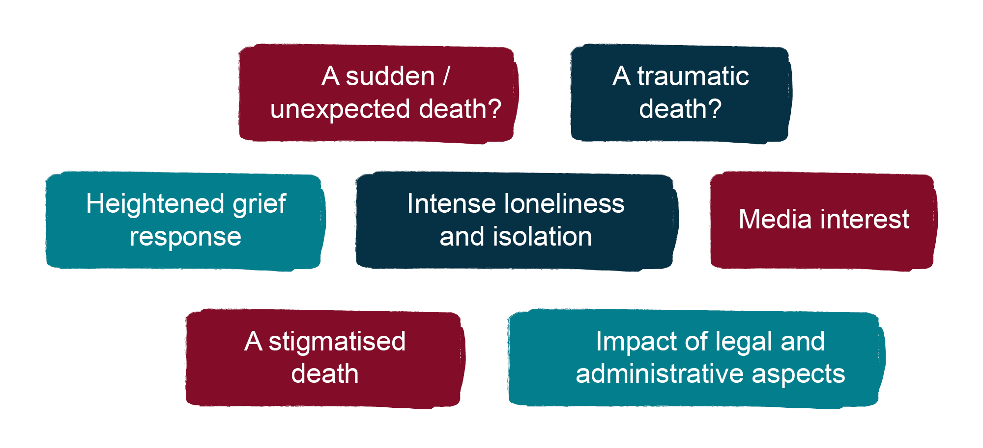
Why is bereavement by suicide different?
Notes:
Assumptive World Theory
When life is running normally we assume that our world will always be like this.
Our assumptive world refers to our view of reality; it’s our working model of the world, a personal theory of reality. If it changes suddenly we are thrown into shock.
Clare: “Life was okay, safe, secure. Dad wasn’t good at listening but he was there, he was my handy man, financial advisor, dog walking companion, early morning tea maker, he cared. That morning I gave him a kiss and we talked about what we were having for tea then I left to go to work. I came home at 6.30 to find the police on the doorstep; my Dad had died at about 3.45. My step-mother found him hanging. I froze, then collapsed. I never slept in my family home again, I never went upstairs again. I went to live with my boyfriend’s family. We tried to sell the house but it fell through when people knew about the suicide. In the end we handed the keys back to the mortgage company”.
Shattered assumptions:
The perceived intentionality of suicide runs counter to deeply help concepts about life (note here that some believe that suicide is not a choice, but the only possible response to an unbearable situation).
Our core assumptions are shattered by the traumatic experience of suicide. Suicide seriously challenges our fundamental assumptions that our world is safe and secure.
There is a need to integrate the suicide into our fundamental understanding of our world; this is not ‘normal’ change.
Trying to understand why someone died in this way is an attempt to manage this psychological crisis.
Assumptive world – origins of term in bereavement work (references if needed)
The term “assumptive world” was first used in the context of bereavement by C. M. Parkes (1975) to refer to people’s view of reality: “…a strongly held set of assumptions about the world and the self which is confidently maintained and used as a means of recognising, planning, and acting […] Assumptions such as these are learned and confirmed by the experience of many years.” (From Parkes, C. M. (1975). Determinants of outcome following bereavement. Omega, 6, 303-323.)
Later developed by Janoff-Bulman (and others): “At the core of our internal world, we hold basic views of ourselves and our external world that represent our orientation to the push and pull of the cosmos. Our assumptions […] are guides for our day-to-day thoughts and behaviours.” (From Janoff-Bulman, R. (1992). Shattered assumptions: Towards a new psychology of trauma. New York: Free Press).

Slide 22
Suicide doesn’t always look suicidal
Notes:
Trainer to revisit the take a few deep breaths, make the exhale longer than the inhale, calm down that sympathetic nervous system, no danger here.
https://vimeo.com/user207261572/stay?share=copy
Bring me Sunshine – Suicide does not always look suicidal
See how the video lands and unpack
Talk about the simple fact that talking about suicide does not cause suicide
Mindful of the ripple effect, those bereaved by suicide are now closer to not just the concept but the actuality, the feelings and the outcome, they are at greater risk.

Slide 23
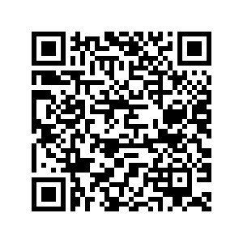
The voices of 7500 people
Notes:
Kirsty – ive deleted the next two slides as we cannot use them – especially now kelly sending out the slide deck

Slide 24
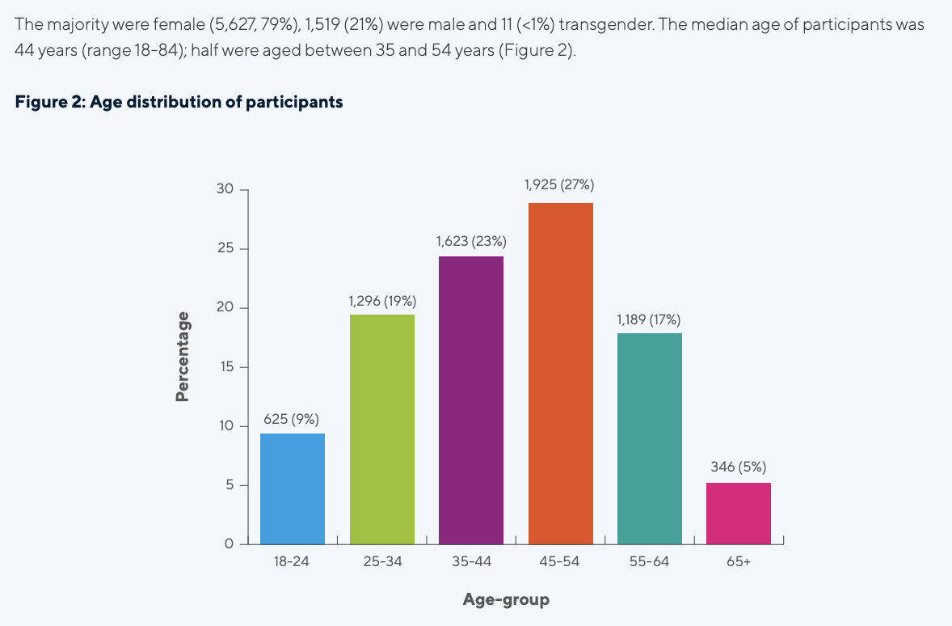
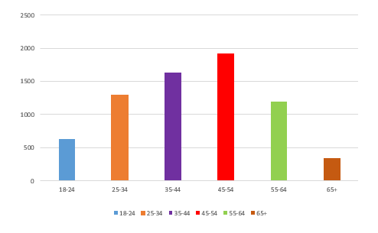
Age distribution of participants
Notes:
Age-Range 18-24 625
25-34 1296
35-44 1632
45-54 1925
55-64 1189
65+ 346

Slide 25
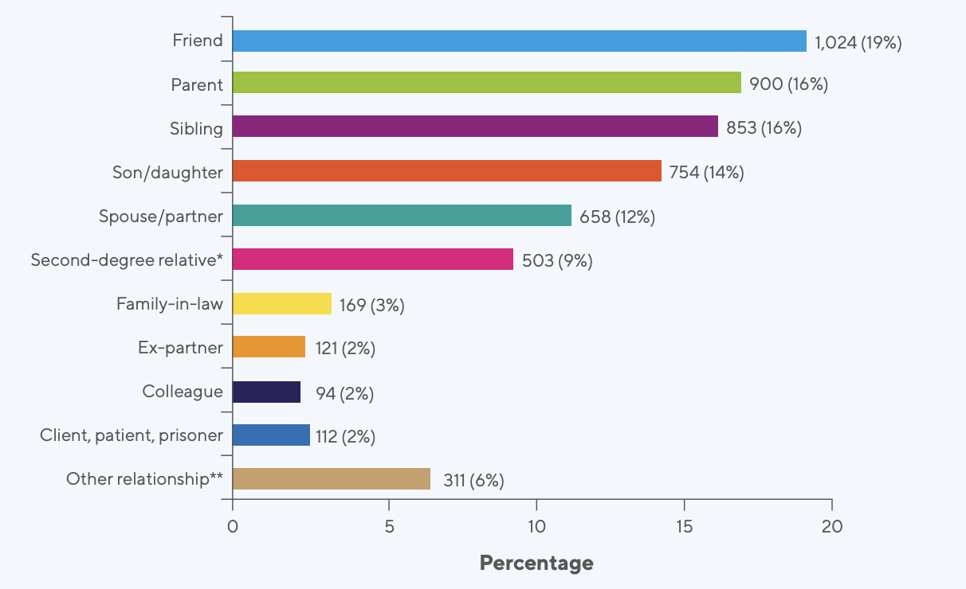
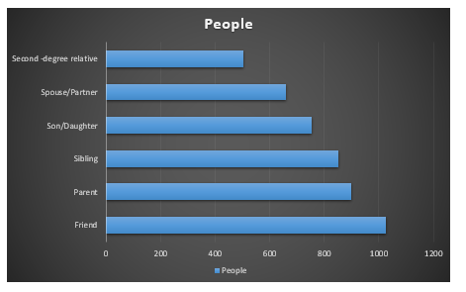
What was the relationship – the six largest groups
Notes:
People Friend 1024
Parent 900
Sibling 853
Son/Daughter 754
Spouse/Partner 658
Second -degree relative 503

Slide 26
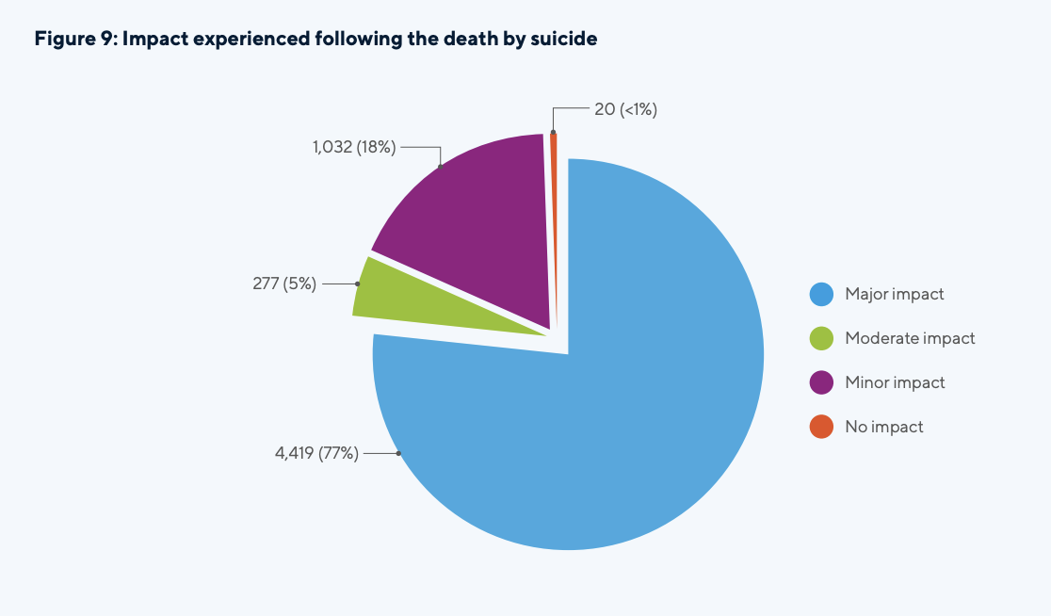
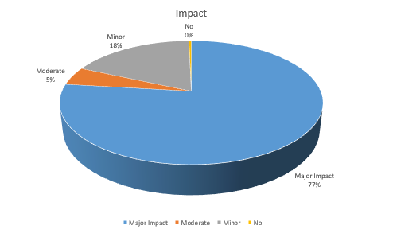
Impact experienced following death by suicide
Notes:
In numbers
Major 4419
Moderate 277
Minor 1032
None 20

Slide 27
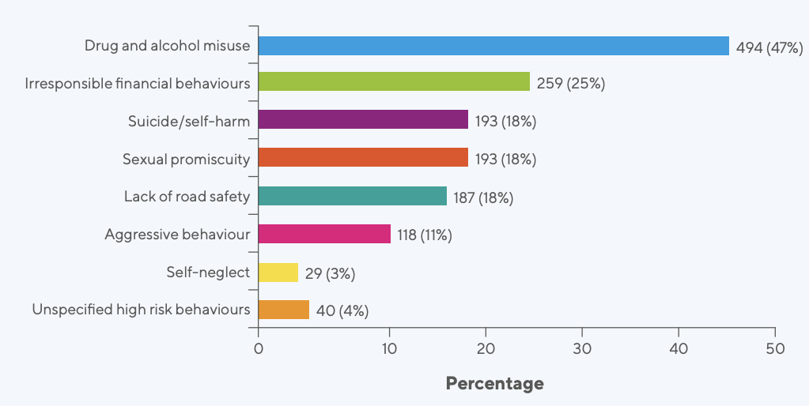
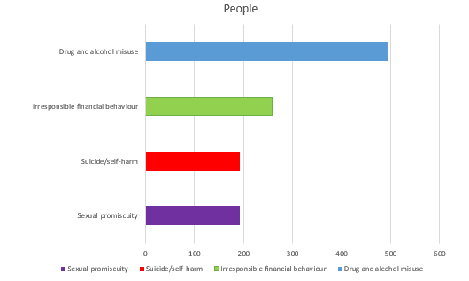
How did that impact manifest – top four
Notes:
Focus on point three

Slide 28
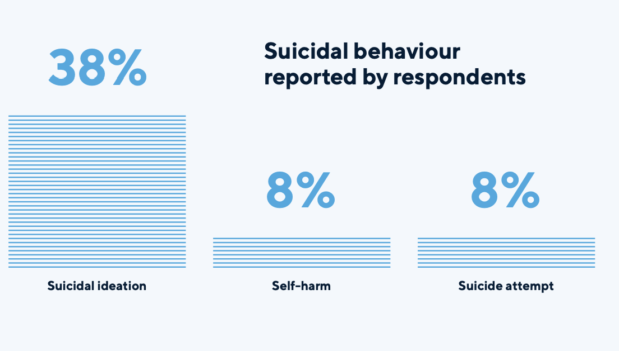
Suicidal behaviour reported by respondents
%
percentage

Slide 29
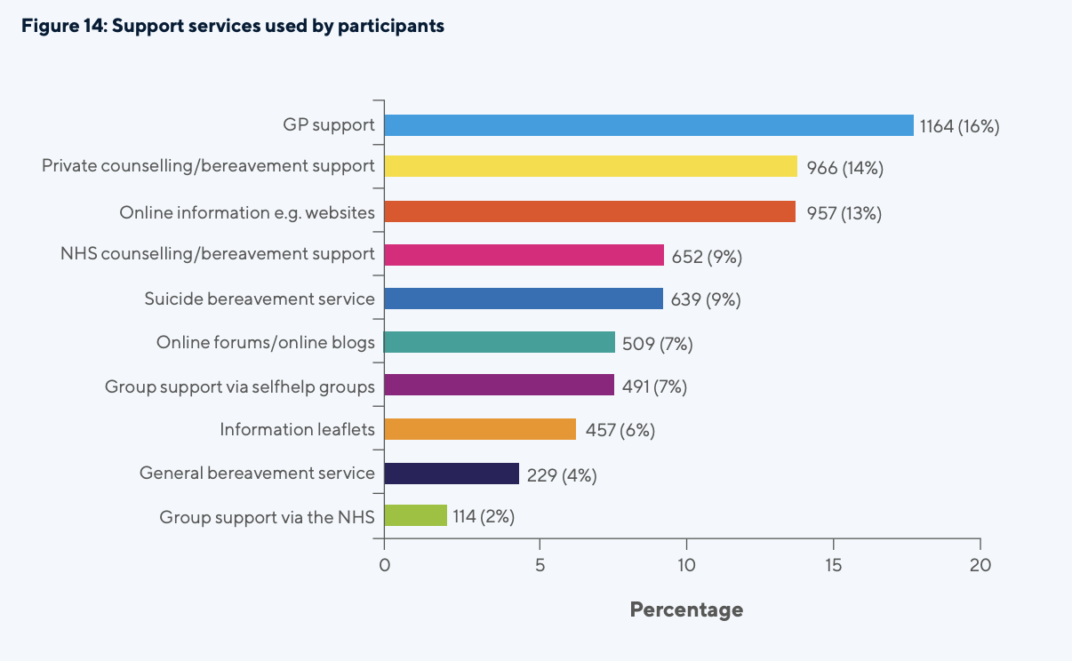
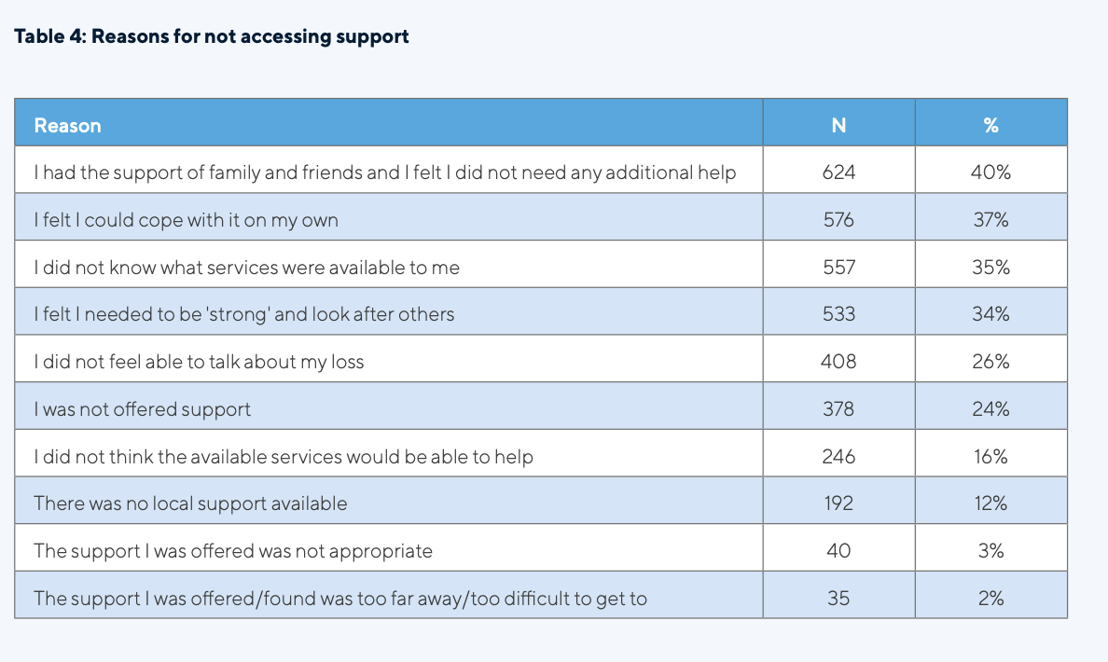
Support Services, used or not – top three
Reason | No. | %
I had the support of family and friends | 624 | 40%
I felt I could cope on my own | 576 | 37%
I did not know what services were available to me | 557 | 35%

Slide 30
What type of support – top three

Slide 31
The common perceptions on motivation
Manipulative
Martyr
Rational
Euthanasia
Mass suicide
Intentional
Relief from unbearable problems, no way out, flight.
To make someone feel guilty, coercion, threat.
Alternative to life if suffering from ill health or terminal illness.
Assisted suicide.
Sometimes associated with religious cults and sects.
Sacrificing life for a political or religious cause.
Desperation
Perceived to be the only way to stop pain
Notes:
Andy L comments
What is the purpose – often they can be stigmatised –
My reflection – perhaps that’s why we mention them in this safe environment
Draw out that some / most of this can be stigmatising to the majority of people

Slide 32
Problem solving capacity
Some capacity
Reduced
capacity
Notes:
Lucid thinking and higher levels of emotional wellbeing
Breadth of problem-solving capacity
Medium levels of distress leading to a crisis
Some problem-solving limitations
Suicidal crisis/severely reduced problem- solving capacity
However, in many instances, people indicating a level of suicidal thinking and feelings are not at an immediate risk level.
It is therefore important to understand what best routes there are to take when mitigating any risk present,
Part of having suicidal thoughts and feelings is that one’s thinking can be impaired and thus, one’s problem-solving skills can become limited. The more a situation is perceived as a crisis, and the more suicidal someone becomes, the more limited their problem-solving skills will become, up until a point when there is only one option left of escaping the terrible situation someone feels they are in, and that is suicide.
The aim of the rest of the call is therefore to deal with the client’s query and concerns in a supportive and structured manner. In helping them play a part is solving their problem, in a realistic manner. You are then increasing their problem-solving capacities and steadily reducing the level of suicidal risk that is present.

Slide 33
Immediacy of Risk
What is Acceptable?
What is Available?
Notes:
Using PP22: the BV/Helpline Volunteer/staff member works out the immediacy of risk by identifying what means are acceptable (how?) – usually one or two methods can be named by the client (eg stash of tablets, kitchen knife). Then they find out whether they have the means available. Go through
Handout 12: Establishing immediacy of risk, outlining all the steps.
Establishing immediacy of risk Handout 12
If a client does indicate that they are feeling suicidal, and has expressed what plans they have to carry out an attempt, the next step is to undertake what is called ‘The A Test’:
• Acceptable – What means are acceptable to them contemplating suicide? Generally people tend to opt for one or two preferred means (eg hanging, poisoning, jumping).
• Available – This is establishing if the preferred means are available to the client. Some means are more available to the general public than others (for instance, it is usually easier for many people to obtain medication than a firearm).

Slide 34
I jumped
Notes:
Video is 7.5 minutes
https://vimeo.com/user207261572/jumped?share=copy

Slide 35
Some signs of Concern
Historical
Emotional Response
Cognitive Response
Physical well Being
Behavioural response
Complex childhood / Abuse / History of exposure / Mental health / Addiction
Strong Emotions / Hopelessness / Isolation / Entrapment / Burden/ Cry of pain
Ruminations / Negative thoughts / Self-criticism / Fearlessness – death / Obsession / Trauma / Loss of Interest
Lack of self-care / Chronic pain / Substance abuse / Treatment resistant illness
Impulsive / Risk Taking / Lack of routine
Circumstances of Death
Sudden / traumatic / Painful / Suicide / Ongoing Process - inquest
Notes:
Andy L comments folded in
As a GFA we focus on the signs of concern and the risks the client is facing
As a GFA what help can we make sure they can access, how soon, to help them stay safe.
If during a session they are not “safe to leave” what we do then is (most likely) call upon alternative services or emergency services.
This slide is awareness rising

Slide 36
How to Support
Allow the person to tell their story uninterrupted, more than once.
Mirror their language
Work with the person's metaphors (“Hollow inside”, “Trapped in a dark place”, “Thrown up on the beach”.
Acknowledge feelings.
Acknowledge any progress however small.
Check out at the end of the session how the person feels and how they will care for themselves/get help from others.
Signposting.
Notes:
Mitigate risk
Question further about risk – what is supporting them and what is keeping them safe (for example, dependents such as children, grandchildren or a pet).

Slide 37
How we help
B
Breathe (To Focus)
K
Keep safe (From Harm)
E
End (Summarise)
L
A
Listen (To Understand)
Ask (To Discover)
Notes:
Responding proactively and confidently - participants can make use of the following models to help them remember how to respond.
Talk through each of the steps covered in
PP6: BLAKE model; PP7: ASIST model; PP8: STORM model. BLAKE helps us regulate how to react, and then how to respond.
Handout 6: Models to help when connecting with a Suicidal Client.
https://www.abi.org.uk/products-and-issues/lts-public/issues-in-long-term-savings/vulnerability-guide/case-study-4/
BLAKE
Use the mnemonic BLAKE as a simple protocol to regulate initially how you react to a distressing call, and then respond to the client so as to promote a beneficial engagement. This practical model takes you through a process with a client from beginning to end. Self-care is highlighted. Taking a breath at the beginning of the call can have a profoundly positive effect on your ability to listen and think clearly afterwards. This model recommends finding out the exact location of the client. There is a determination of risk; very high and high risk being associated with specificity of a suicide plan, a clear intent to die, evident self-harm and an inability to respond from the client.
Breathe – it can be scary to hear something like this, so take a moment to simply breathe and focus your thoughts. You can do this by acknowledging what the customer has said: “I’m so sorry to hear you feel that way. How can we help?”
Listen – we always take what the customer has shared seriously, but we also always listen carefully so we can assess the imminent risk of harm. Listen to the customer using verbal nods and recapping key information to show your understanding.
Ask – listening is important, but where gaps continue to exist in your understanding about the current situation, you should ask questions to fill these. Example questions could include: “What has led to these feelings?” or “Have you spoken to anyone about how you are feeling?.
Keep safe - Based on your understanding of the situation, and also the Cruse Safeguarding Policy, the Emergency Services should be contacted if the client is at imminent risk of harm. They will assess the situation and make the decision as to the next step. During this, you may need to stay on the line to keep talking with them. Reassure them your primary concern is their safety.
End – Once the client’s safety has been addressed, if it is possible to do so, summarise what has been discussed and agreed, so that the call can end.
If time, initiate a discussion on where trainees see Cruse support on the continuum of informal support and formal support. It is suggested callers/clients regard Cruse somewhere in between. Cruse can offer something unique that friends/family/Samaritans/GP/mental health professionals may not. Much of this is based on the person-centred approach, the care which is provided recognizing the impact of bereavement and cumulative losses, the valuing of life and keeping the person safe.
Effects of hearing about suicidal thoughts and feelings
We can experience all sorts of thoughts, feelings and bodily sensations when we hear someone talk about killing themselves. These commonly include:
Thoughts Feelings Sensations
“What do I do?” “What do I say?” “It will be my fault!” “I don’t know what to do” The absence of any thoughts
Shock Panic Blankness Sadness Anger
Rapid heart beat Dry mouth Inability to speak Numbness Trembling
These all usually denote an entirely normal response to hearing something very distressing, and are reactions not to be concerned or self-accusatory about. They are part of our entirely human response to a very horrible situation – which is to avoid the situation. As humans, we broadly react in the following ways:
Positive situation - something we like and something we want to do
Negative situation - something we dislike or feel threatened about
Approach
Avoid
However, we can take control and help ourselves exercise choice when faced with either. This is the case when working with suicide. We can take steps to help ourselves that will then help us help other people.

Slide 38
Stay
Notes:
https://vimeo.com/user207261572/stay?share=copy
Remind trainees – they could be the person that gets someone to stay
Samaritans – telephone 116 123, text or chat - https://samaritanshope.org/
• Papyrus suicide prevention for under 35s 0800 068 41 41 https://www.papyrus-uk.org/
• Shout 85258 is a free, confidential, 24/7 text messaging support service for anyone who is struggling to cope. https://giveusashout.org/
• Young minds – under 19, text "YM" to 85258, partnered with Shout https://www.youngminds.org.uk/young-person/youngminds-textline
• Stay Alive –An app full of useful information and tools to help you stay safe in crisis.www.prevent-suicide.org.uk/findhelp-now/stay-alive-app
• CALM – exists to prevent male suicide 0808 808 7777 https://nspa.org.uk/member/campaign-against-living-miserably-calm/
• MINDS – PDF that explores suicidal feeling, causes, support and how to help yourself for the person feeling suicidal https://www.mind.org.uk/information-support/types-of-mental-health-problems/suicidal-feelings/about-suicidal-feelings/
• Helpguide – an ad-free, not for profit website, offering guidance and encouragement to prevent illness and improve health. The link is for suicide prevention and how you can help yourself. https://www.helpguide.org/home-pages/suicide-prevention.htm
om/755414521/1755914374

Slide 39
Your workplace action plan
Notes:
FIRST THINGS WHEN YOU GET BACK – WHITEBOARD COLLABERTAIVE GROUP CHAT
COMMUNICATE YOUR ROLE
IDNTIFY WHO CAN HELP YOU
INSERT YOURSELF INTO THE POLICY
IDENTIFY YOUR RESOURCES
GET BUY IN FROM THE COMPANY – SUPPORT THAT YOU WILL NEED
SUBSCRIBE TO CRUSE SOCIALS

Slide 40
“Organisational good practice”
Plan: Have a written plan that outlines how the business will treat bereaved customers with empathy and respect.
People: Train staff and make sure everyone who comes into contact with bereaved people knows how to respond efficiently and with understanding.
Process: Streamline processes and procedures to be simple and pragmatic. Avoid unnecessary steps and repetition.
Paperwork: Ensure paperwork is easy to follow and only asks for information that is needed. Pass on details of where people can get practical and emotional support.
Notes:
Dependent upon company size
A small company the GFA may be the CEO. Or the GFA may be one person in a site of 600 people and have no organisational input at all

Slide 41
Adopting the role

Slide 42
Congratulations
Notes:
Emphasise – keep in touch
Download the app

Slide 43
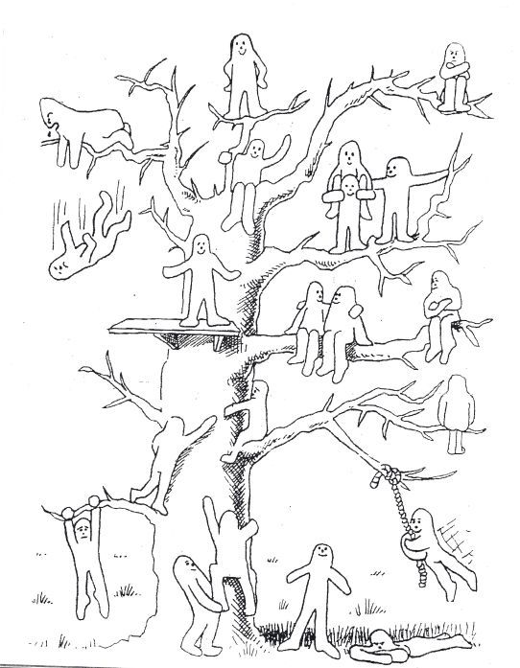
Where are you now?
Notes:
Who can you identify with on your blob tree
Trainer to ask
Are you excited, climbing, hanging on, enjoying the view

Slide 44
Ways to work with us
Fundraising – from a cake sale to running the marathon
Training – providing organisations with the skills and knowhow to improve how they deal with bereaved people
Corporate partnerships and Charity of the Year
Campaigning – help us make the voice of bereaved people heard by businesses and policy makers
Volunteering – we couldn’t support anyone without our fantastic team of volunteers.

Slide 45
Thank you.
fundraising@cruse.org.uk
training@cruse.org.uk
www.cruse.org.uk/get-involved
www.cruse.org.uk/donate

